Slide 1

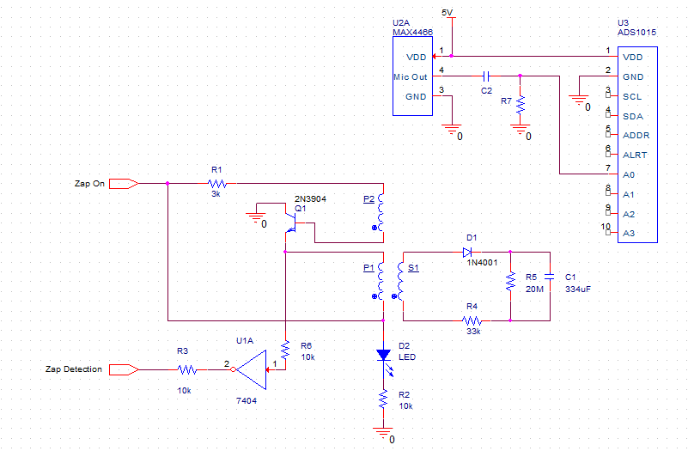
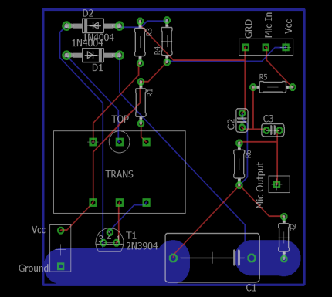
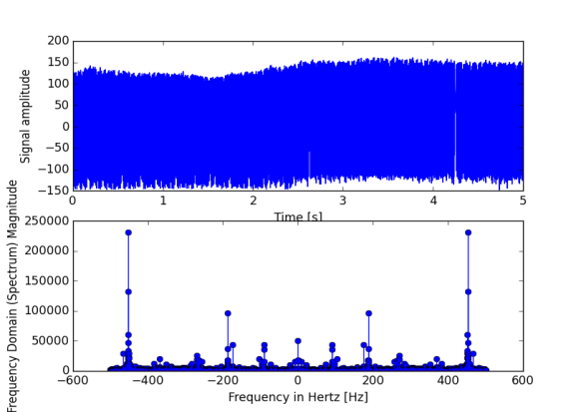
Electrical and Computer Engineering, Fall 2016-Spring 2017
Mosquito/Bug Zapper
Frank Yee, Ricky Zhang, Thomas Suarez
Prof. Westerfeld
Objective
Design and PCB
Design an effective way to control mosquito population through the means of a better mosquito trap
Electret microphone and controlled zapper
Approach
Programming a Raspberry Pi 3 model B to conduct digital signal processing (via Fast Fourier transform) on recorded flight tones, and control system response
Digital signal processing
The top waveform is a recorded signal of 450Hz. Bottom graph shows which frequencies were detected (450Hz is confirmed present)
Impact on Society/Environment
Saving life from mosquito-borne diseases, at the cost of disrupting natural food chain

